Slide 1
Requirement Analysis

Slide 2
1.0 Purpose
To provide ready-to-use Tutorials on pre-selected topics.
Ability to search for specific tutorial.
Service which allows users to request for new topics.

Slide 3
1.1 Intended Audience
Students pursuing technical education.
Teachers or tutors in technical field.
Business entity trying to use newly designed logic.
Person in research field trying to apply different logic to prove their theory.

Slide 4
1.2 Project Background
The project contains intensive use of web crawlers as well as machine learning techniques.
Both web crawlers and machine learning techniques have been used extensively independently but not together.
This project tries to tie a knot between both techniques.

Slide 5
1.3 Objectives
Implement web crawlers to crawl to crawl the web and search relevant data.
Store relevant data in data bank effectively for further processing.
Implement machine learning technique to extract required data from data bank efficiently to build the tutorial.

Slide 6
Objectives
Gather all the relevant pieces of data together and build tutorial using literature analysis.
Store tutorials in database to be accessed by front end
Implement easy to use front end which will provide services to display , search and request new tutorials.

Slide 7
1.4 Benefits
The system will provide ready to use tutorials for students, teachers, researchers and business entities.
System will save users time to search information on new topics.
If user is completely unaware of a particular topic then this system will be very helpful.
User can spend more time studying the topic than searching on it.

Slide 8
Benefits
User will get more point of views than if user was studying from a book.

Slide 9
1.5 Stakeholders
Stakeholders in this project are the intended audience as the project logic does not acts as a plug-in but as whole system.

Slide 10
1.6 Dependencies on existing systems
Project uses web crawler system and literature analysis system
Both systems have been developed already
Use of both systems in single application is rare
Web crawlers are backbone of this project which further uses literature analysis as compiler.

Slide 11
1.7 Assumptions
<<
Describe the major assumptions that were made prior to or during the business requirements gathering and documentation.
>>

Slide 12
2.0 Requirements Scope
Requirements scope is outlined as –
2.1 In Scope
2.2 Out of Scope

Slide 13
2.1 In Scope
The system will provide tutorials related to technical topics.
This shortened scope of system ensures efficiency of system.

Slide 14
2.2 Out of Scope
Topics related to arts and such topic are omitted.
Such topics have lot of vagueness and redundancy.
Literature analysis may fail due to this.

Slide 15
3.0 Functional Requirements
<<
Describe the functional requirements of the project here.
[Functional requirements define how the BPM system should function from the end-user's perspective. They describe the features and functions with which the end-user will interact directly.
When interpreting and recording requirements it is important to clearly define and prioritise them, analyse the impact of change, resolve conflicting issues and analyse feasibility.]
>>

Slide 16
4.0 Non-Functional Requirements
<<
Define the operations that must be carried out in the background to keep the product or process functioning over a period of time and the required service standards
>>

Slide 17
5.0 Technical Requirements
Powerful web server to handle traffic from web crawlers
Good web crawler architecture.
Large memory space for data bank.
Efficient literature analysis logic.

Slide 18
6.0 Interface Requirements
<<<
Describe the User and System Interface requirements for the proposed system.
7.1 User Interface Requirements
Describe how the users will interact with the system, in particular any manual processes to be carried out outside of the system.
Also describe the user interface requirements. Include or attach a screen prototype diagram here.
7.2 System Interface Requirements
Describe the other systems with which the BPM system will interact, both as inputs and outputs. Outline any automated control and reconciliation requirements as well.
List and describe what other external systems/business functions are required to be interfaced with the proposed system from Business Requirements perspective. Example: This system needs to interface with the CAS in order to receive some input data.
[Note: Avoid describing system design and technical issues.]
>>>

Slide 19
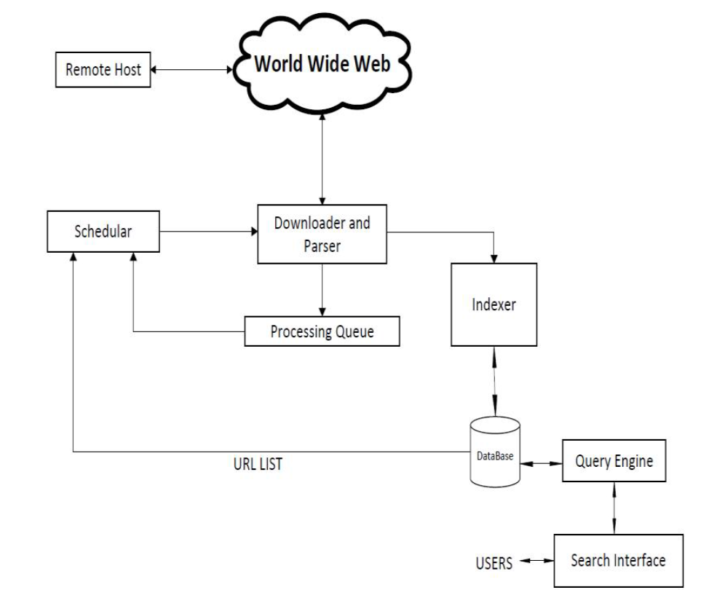
Web Crawler Architecture

Slide 20
Basic Working
Select starting seed URL or URLs.
Add it to processing queue.
Now pick URL from processing queue.
Fetch the web page corresponding that URL.
Parse that web page to find new URL links.
Add all the newly found URLs in processing queue.
Go to 2nd step until queue is empty.

Slide 21
Classification
Based on following parameters:
Coverage area
Mobility
Domain specific
Load dustribution

Slide 22
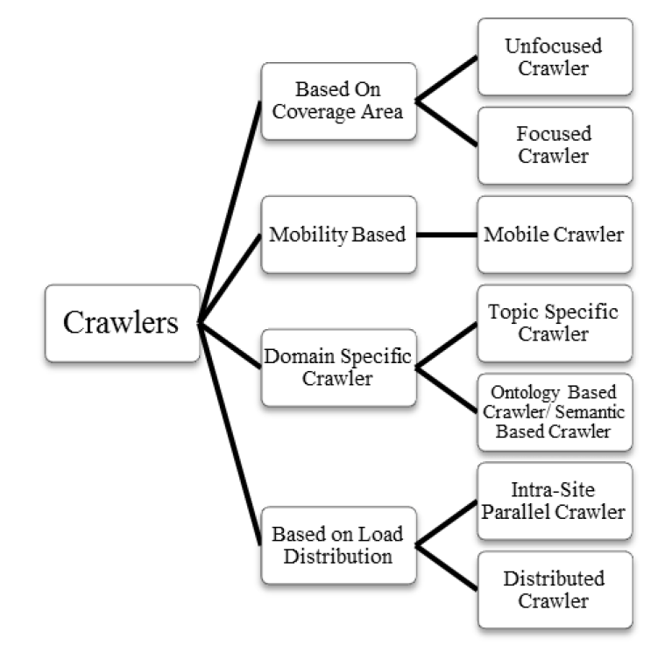
Classification

